Slide 1
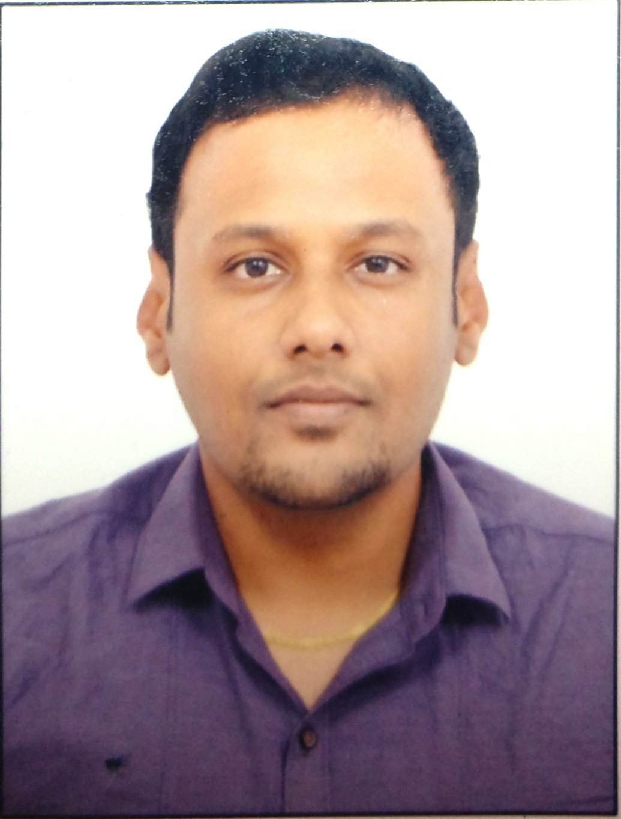
N.Senthil Vel Murugan
TECHNICAL Expertise
Industry Domain
Cloud Transformation
Specialist
India
Phone : +91 8095082153
Email : senthil.vel.murugan@accenture.com
Cloud Migration using Azure site recovery and Az Migrate
Terraform and ARM
Windows / Linux administration
Healthcare
Pharma
Insurance
Relevant Experience
Projects: Celanese, LAWA
Technology: Azure, Terraform
Worked as a Terraform engineer to deploy Virtual Machines, Storage, Load Balancers, etc for Celanese, a major Chemical Manufacturing client in US.
Migrated VMware hosted workloads to Azure using Azure Site recovery.
Co-ordinated a team of 8 members for migration planning and execution.
Worked as an IaC engineer to deploy landing zones for LAWA, an Airline operations client in West Coast of US. Used Terraform to deploy vnets, storage, monitoring tools, key vaults, nsgs, endpoints and VMs.
Projects: BrightHouse Financial, ThyssenKrupp, Astellas, Shiseido
Technology: Azure, ARM, Windows/Linux
Worked as a Cloud Build engineer for a major insurance and Pharma clients in US. Deployed Cloud resources using ARM templates and administered Window and Linux machines during cutover and hypercare before the ops team takes over.
Setup SFTP solution for 3rd party etl connectivity to client machines and established both pass based and key based authentication.
Collaborate with client ops teams and service providers for troubleshooting issues impacting deliverables.
Projects: Haleon, Siemens China
Stabilization of SAP enterprise systems in Azure by assessing and implementation of HA for critical business systems.
Drive the Azure implementation and Windows remediation identified during health assessments.
Setup Azure Automation accounts and WSUS for automatic patching solutions for various customers
Professional Background
Associated with Accenture since July 2011 and with total IT experience over 12 years.
4+ years of relevant experience on Cloud build and Migration, Sap On Azure , IaC (Terraform, Arm) and other workload migration using ASR and Azure Migrate.
8 years of experienced in IT Service Management and was part of Command centre roles. Excellent communication and business writing skills.
Certifications & Education :
B.E ( Electronics and Communication engineering Engineering)
Entry and Admin level: AZ900 and AZ104 (Microsoft Azure Administrator)
Professional Level: AZ305 (Designing Microsoft Azure Infrastructure Solutions) and AZ120 (Planning and Administering Microsoft Azure for SAP Workloads)
Copyright © 2023 Accenture All rights reserved.
1

